Slide 1
Comprehension of Complexity
C_{C}

Slide 2


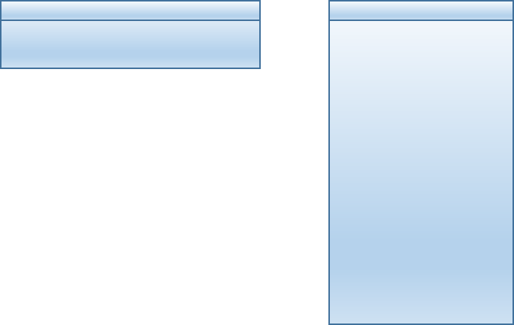
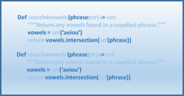

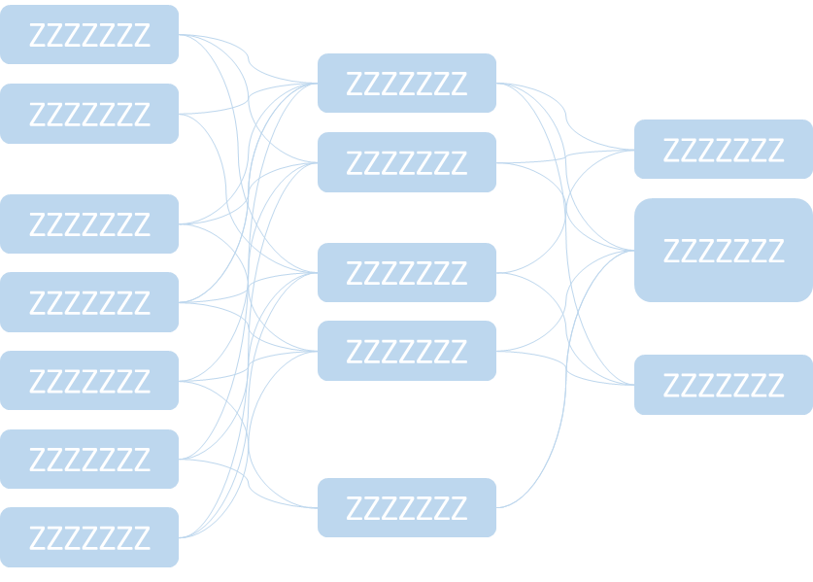
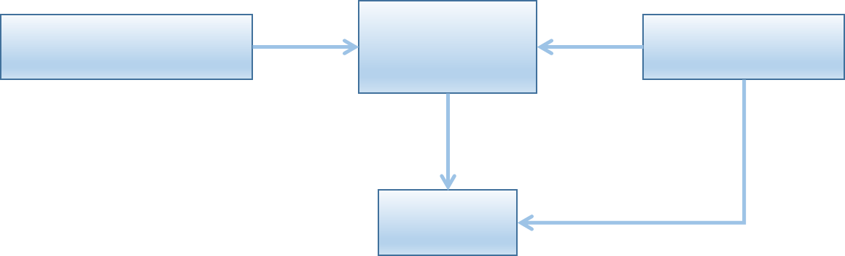
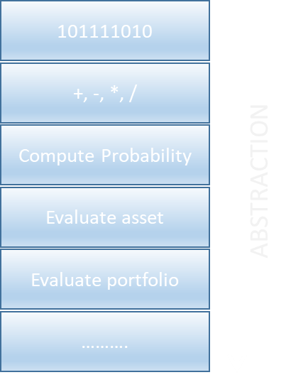
Complexity Comprehension Levels
LEVEL I
LEVEL II
LEVEL III
AUTOMATED
COMPLEXITY
LOCALIZED
COMPLEXITY
SYSTEM LEVEL
COMPLEXITY
System Complexity
Mastery of Complexity Comprehension
Mastery comes from the Synthesis of Experience
Time

